Slide 1
Student podcasts in class
An ear-resistibly fun and creative assessment tool

Slide 2
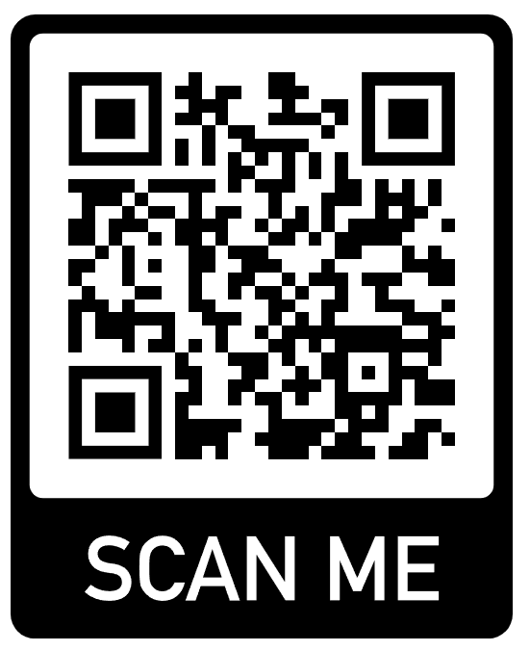
Overview
Structure of the talk
Benefits of podcasts
Engagement, communication skills
Structuring the assessment for your class
5 check-ins/steps throughout the process
Small group discussion
Podcasts in your class
“Behind the scenes” (making of the podcast)
Technical and content tips
Q & A
Resources provided (Scan QR code)
Instructions for every check-in/step of the process
Tips & resources notes
Peer review guidance & rubric
https://github.com/CaseyGio/Podcast

Slide 3


Teaching scientific communication
About 1 in 5 Tik-Tok videos likely contain misinformation
Scientific literacy of content creators & end-users is limited
Can we teach people to better present science? Of course!
“Communication skills” is a universally sought-after job skill
Presentation skills is second only to verbal communication
Scientific communication is really hard, podcasts can help
Translating jargon into everyday language
Creating engaging content on in-depth material for non-experts
Simplifying complex ideas to non-experts
Analyzing research and arguments to inform others
Spark interest in a topic through effective storytelling

Slide 4
New tool, old ideas: Podcasts as presentation
Presentations are a good assessment tool
Podcasts are more accessible, less stressful, and emphasize braod skills
Similarities
General presentation skills matter (organization, speaking)
Research and preparation are required to do well
Engaging the audience is important
Differences
Functional fixedness: creativity discouraged in traditional presentations
Added control over the presentation
Recorded format allows for editing & re-recording
Reduces anxieties of in-person, one-take, live presentations
Permanence of product
Portfolio & resume building, grad admissions, etc.

Slide 5
The value of podcasts
Deeper intellectual engagement with topics
Necessarily entails active learning
Creative expression & topic selection helps engagement by personalizing the product
Sense of ownership over their final product
Skill development, resume line items
An actual, recorded product that can be shared with others
Scientific research to gather, weigh, and create a story to explain complex ideas
Technical skills in sound editing, script writing, recording
Collaborative learning
Shared responsibility helps make a daunting project easier
Different viewpoints, debates are even encouraged
Students can play to their strengths in a group
So, how do we implement a podcast in our courses?

Slide 6
Structuring the podcast assessment
Multiple check-ins helps students & faculty
Reasonable and continued progress across long period of time
Feedback opportunities
Diligent work on first steps make the final podcast stronger
Personnel Selection & Talent Management
My students had a smaller project during the first few weeks
Week | Check-in stage | Time to complete
4 | Podcast & groups assigned | NA
4 | Topic selection & brainstorming | 2 weeks
6 | Outline & planning | 2 weeks
8 | Podcast creation | 4 weeks
12 | Peer review | 2 weeks
14 | Project & self reflection | 2 weeks

Slide 7
Check-in 1) Groups & topic selection (2 weeks)
Generally recommended group sizes
Graduate students: ~2
Undergraduates: 2 to 5
I prefer randomized groups
Fairness, nobody “left out”
Diligently selected groups by instructor may be preferrable
Topic: “Fairness and/or bias in personnel selection”
My choice was general topic for the whole class
Groups pick a topic within (e.g., AI screening biases, disability discrimination)
NOTE: 2.5 groups had the same topic by chance
Submission content:
Topic – what they will talk about
Purpose – what they want to achieve (inform, convince, critical review, etc.)
Audience – who they will address (grad students, gen public, policymakers)
Content ideas – key points, stories, examples, research to address in podcast

Slide 8
Check-in 2) Outline & plan (2 weeks)
Very similar to other presentation/paper outlines
Additional consideration of podcast elements
Submission materials are bolded elements
Introduction: How is the topic introduced
What’s the ‘hook’?
Statement of podcast’s purpose/intention
Content: How will you achieve the purpose
What’s the logical sequence for the podcast
What’re the main points, key lines of evidence
How will you transition between main points
Conclusion: How will you wrap up
What’s the ‘call-to-action’
Summarize main point(s)
Additional submission materials:
Added podcast audio/video elements: e.g., sounds, clips, music, etc.
Group responsibilities: Who is doing what (“Both must be recorded roughly equally”)

Slide 9
Check-in 3) Record the podcast (4 weeks)
General assignment details
12- to 15-minute podcast (~10 min for undergrad groups, 5-7 min for solo)
Modality
Audio is required
Video is optional
Scientifically-grounded evidence
No formalized requirement (e.g., “5 peer-reviewed papers”)
Likely want to add some formality
Topic must address “Fairness and/or bias in personnel selection”
Submission instructions (i.e., file formats)
Mp4 is generally universal A/V file format
Audacity or other uploaded resources with accessible link
I downloaded the mp3 from Audacity, best of both worlds

Slide 10
Check-in 4) Peer review (2 weeks)
Instructions
Each person assigned 2 podcasts to review
“Provide helpful, constructive, and at least some positive comments about each podcast”
Peer review guidance
Provide goals of peer review (specific & actionable, build your presentation skills by reviewing others’, strengthen community)
Provide rubric for evaluation
Clarity of ideas, conciseness, organization, psychological application, professionalism
Provide guiding/probing questions for each category in the rubric
Exposure to others’ podcasts is useful
Learn from others (content, presentation skills)
Build community

Slide 11
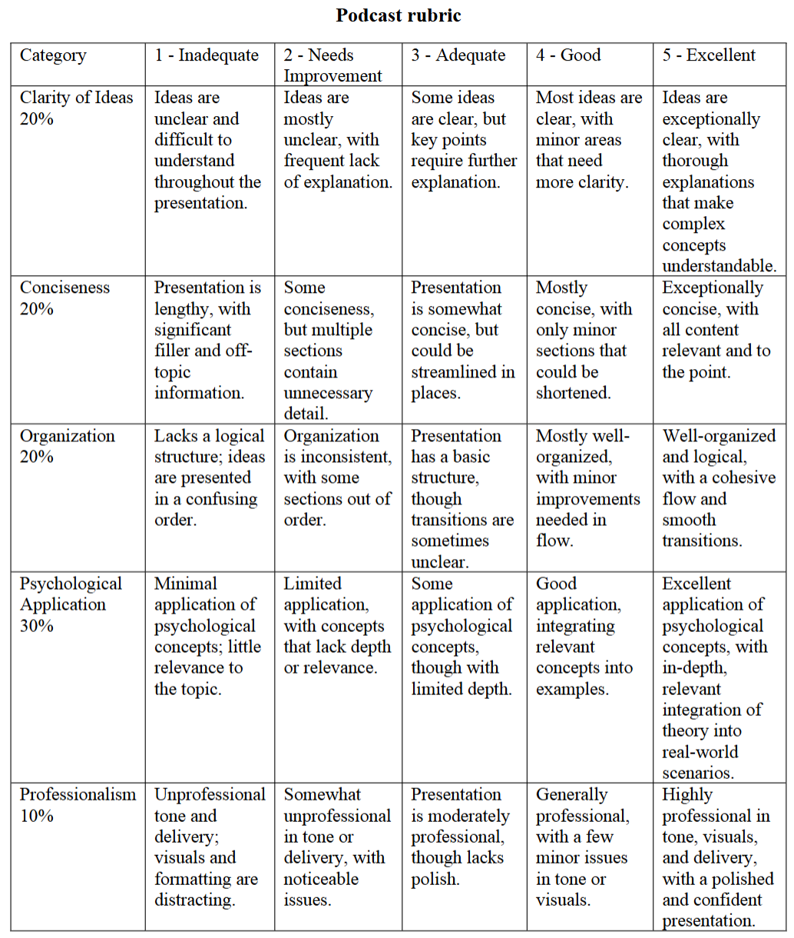
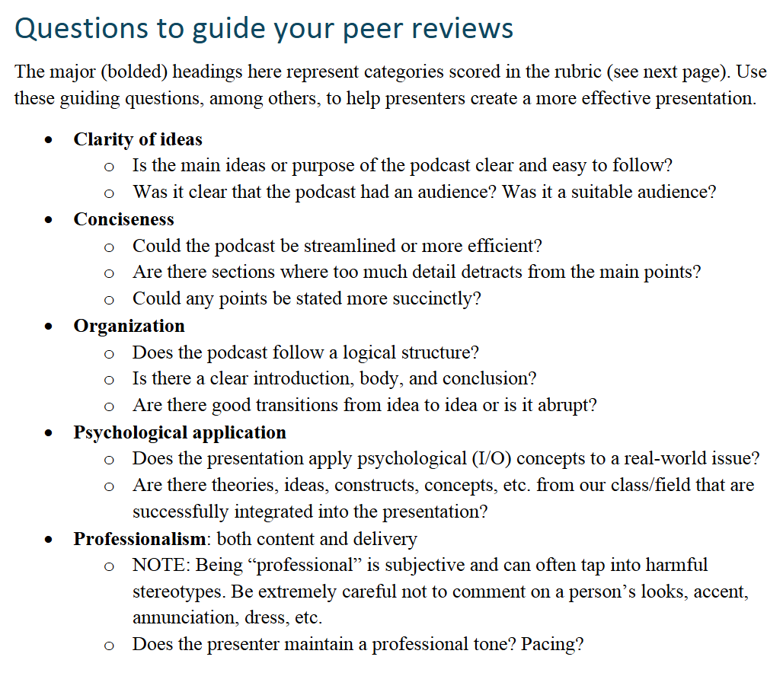
Peer review

Slide 12
Check-in 5) Reflection (2 weeks)
Main instructions
Read reviews, highlight comments that are helpful, challenging, or thought-provoking
Respond to the feedback
Identify 3 pieces of feedback to respond to in detail
About 5 sentences reflection about feedback (valuable? Helpful? Improve your future?)
Reflect on process
250 to 500 word reflection
Insights from peer review
What did you learn about the topic that was interesting, exciting, engaging, etc.
Subjective eval of podcast as an alternative presentation format

Slide 13
Small group discussion
What course(s) that you teach could you implement a podcast in?
How would students identify topics?
General topic for the class, students pick within it
Students self select any class-related topic (with permission)
Assign topics to students based on course content
Other?
What class-related podcast topic would you want to create for your students?

Slide 14

Recording the podcast
I recommend that you also create a podcast
Same instructions & requirements as the students
The Psycholo-Gist by Casey & Moses
“Biases in graduate school admissions”
A ‘first draft’ recording (don’t want it too perfect)
Written script, edited, added sound effects, intro/outro
Why would you make me do this?!
Become a better role model for your students
Your podcast can show exactly what you’re looking for
External podcasts are good references, not perfect
Become a better leader for your students
Lead by example so they feel more comfortable doing it
You learn software skills to guide students that struggle
Notes:
https://audio.com/casey-giordano/audio/personnel-selection-podcast

Slide 15
My process for creating the podcast
Identified the topic:
An interest of mine and professionally-relevant topic
Finding a style:
An interview style (so that I could talk more than my partner)
Script: I wrote the script, didn’t want him to have to say my jokes
Was hard creating script for right time, took multiple iterations
Recording: opened Zoom, hit record, hit end, done
Recorded twice: 1st to test audio and whether it even recorded, work out bugs
Worked off nerves for second recording
Before editing: AI generated cover art, found sound clips
AI is bad at generating sounds (or I’m bad at sounds to make good prompts)
Ominous thunder sound, badum-tss, intro/outro theme,
This was a very pleasing and enjoyable waste of time
Editing
2hr from downloaded software (Audacity) to completed podcast
Listened once through, didn’t bother with a second
Removed breaths, clicks of tongue, removed pauses, imported audio tracks, changed volume & faded music

Slide 16
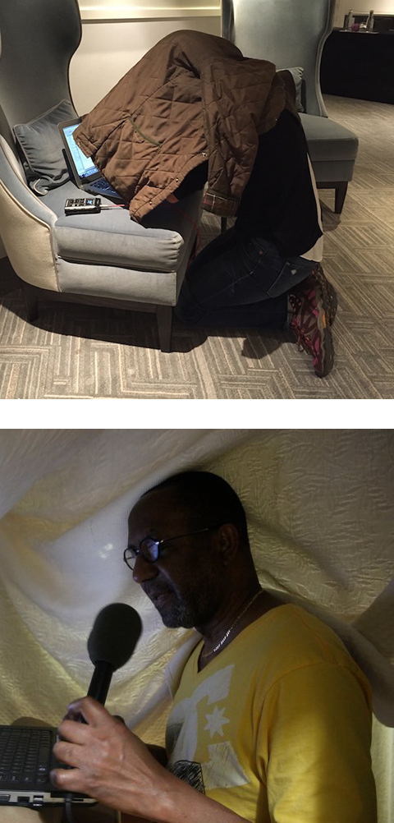
Technical tips
Recording environment
Quiet, non-echoic location
Home office, closets, blanket forts
Blanket & jacket forts used by NPR journalists
Extra equipment NOT NECESSARY
Modern phones have great audio, that’s all you need
Not fool proof, still need to speak into the mic
Software (all done for free)
Editing: Audacity allows free use of editing software with tutorials
Upload audio (mp3 file), edit & publish podcast
From downloading app to finished product, ~2 hours of work
Recording: Zoom is great for recording audio (just need audio file, not video)
General: Noise cancellation software can be nice
Zoom has this embedded
Krisp or 3rd party sources (e.g., Nvidia broadcast on my personal computer)
NPR journalists recording audio
Notes:
https://training.npr.org/2017/01/31/the-ear-training-guide-for-audio-producers/

Slide 17
Content tips
NPR has tons of resources, tips, and tricks for creating podcasts
Starting your podcast: A guide for students
Opening segments of your podcast
Music/sounds, creating scripts, voicing tips, podcast structuring, etc
Listen to other podcasts
How do they begin/end?
Different styles: interview, conversation, co-hosted, panel, storytelling
Create a script, practice reading to sound engaging
Edit script to sound more conversational than academic
During recording, if you make a mistake, keep going
Stop for a moment to reset yourself, start reading your part again
Very easy to edit out ‘bad’ segments!
Can make audio cue (clap) to find it in audio file easier

Slide 18
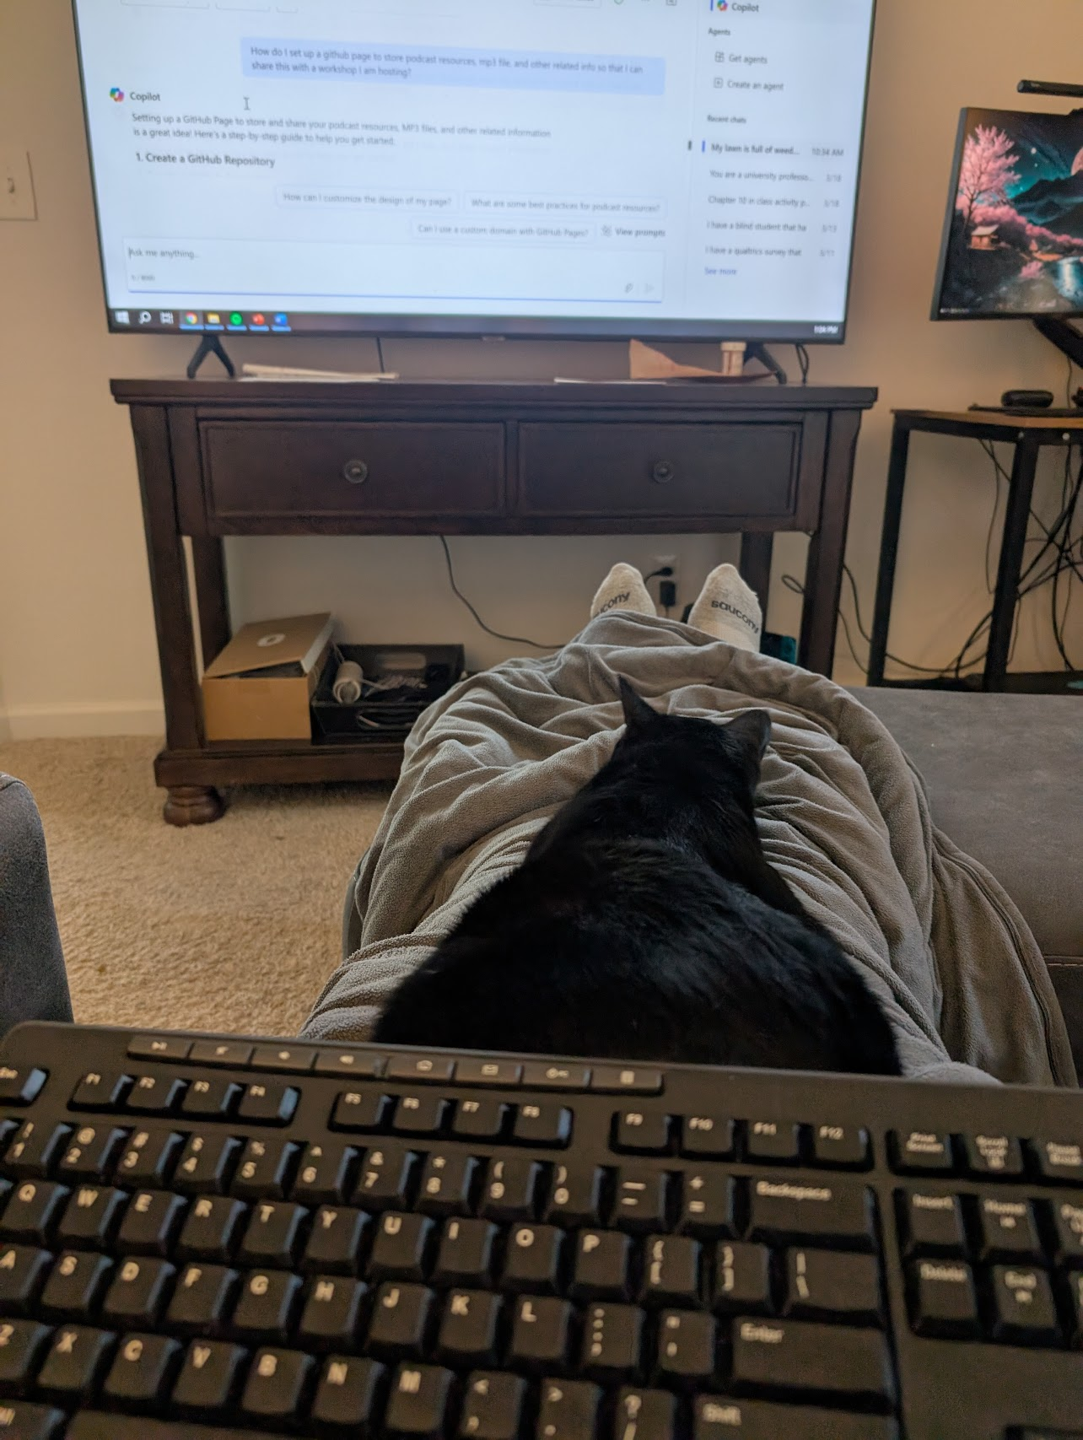
Q & A
Big thanks to my collaborators:
ChatGPT
Microsoft Copilot
NPR
Random grad student at Audrey’s conference talking about podcasts
Toebi
My co-pilot and Copilot
https://github.com/CaseyGio/Podcast

